Slide 1

Internet Programming I
Chapter 4
JavaScript: Regular Expression and Form Validation
Group: 2
3rd Year Sec B Students,
Dept. of Software Eng.
Jan 2022, AASTU

Slide 2

Objectives
After success completion of the session you will be able to:
Differentiate client side and server scripting language.
know the methods of regular expression
validate forms on the cilent side

Slide 3
Outline
Regular expression
creating a regular expression
writing a regular expression patterns
character class or (brackets)
metacharacters
quantifiers
methods of regular expression
flags
Form validation

Slide 4
1. Creating a regular expression
Regular expressions are patterns used to match character combinations in strings.
In JavaScript, regular expressions are also objects.
These patterns are used with the exec() and test() method of RegExp.
And with the match(), matchAll(), replace(), replaceAll(), search(), and split() methods of string.
which means we can use the regular expression to match, replace, search, split.
you can constract a regular expression on two ways
Using a regular expression literal, which consists of a pattern enclosed between slashes, as follows:
let re = /ab+c/;
making the regular expression constant will impeove performance because regular expression literals provide compilation of the regular expression when the script is loaded,

Slide 5
cont’d
The second way is by calling the constructor function of the RegExp object as follow:
let re = new RegExp('ab+c');
Using the function provide run time compilation.

Slide 6
Writing a regular expression pattern
Any character in side the two forward slash is a regular expression.
Using simple patterns
Simple patterns are constructed of characters for which you want to find a direct match.
Using special characters
When the search for a match requires something more than a direct match, such as finding one or more b's, or finding white space, you can include special characters in the pattern.
Escaping
If you need to use any of the special characters literally (actually searching for a "*" , for instance), you must escape it by putting a backslash in front of it.
Using parentheses around any part of the regular expression pattern causes that part of the matched substring to be remembered.

Slide 7
Character class or (brackets)
Expression | Description
[abc] | find any character between the brackets
[^abc] | find any character NOT btween the brackets
[0-9] | find any character between the brackets(any digit)
[^0-9] | find any character NOT between the brackets(any non-digit)
(x) | A grouping or subpatter, which is also strored for later use
(x|y) | find any of the alternatives specified

Slide 8
Quantifiers
Qunatifier | Description
* | match zero or more times.
+ | match one or more times.
? | match zero or one time.
{n} | match exactly n times.
{n,} | match at least n times.
{n,m} | match from n to m times.

Slide 9
Metacharacter
Metacharacter | Description
. | find a single charachter, except newline or line terminator
\w | find a word character
\W | find a non-word character
\d | find a digit
\D | find a non-digit character
\s | find a whitespace character
\S | find a non-whitespace character
\o | find a NULL character
\n | find a new line character

Slide 10
Methods of regular expression
Method | Description
exec() | Executes a search for a match in a string. It returns an array of information or null on a mismatch.
test() | Tests for a match in a string. It returns true or false.
match() | Returns an array containing all of the matches, including capturing groups, or null if no match is found.
matchAll() | Returns an iterator containing all of the matches, including capturing groups.
replaceAll() | Executes a search for all matches in a string, and replaces the matched substrings with a replacement substring.
split() | Uses a regular expression or a fixed string to break a string into an array of substrings.
search() | Tests for a match in a string. It returns the index of the match, or -1 if the search fails.
replace() | Executes a search for a match in a string, and replaces the matched substring with a replacement substring.

Slide 11
Flags
Flag | Description
d | generate indices for substing matches.
g | global search
i | case-insensitve search
m | multi-line search
s | allow . to mach newline characters.
u | “unicode”; treat a pattern as a sequence of unicode code points.

Slide 12
Form validation
When you enter data, the browser and/or the web server will check to see that the data is in the correct format and within the constraints set by the application.
Validation done in the browser is called client-side validation, while validation done on the server is called server-side validation.
There are three main reasons for insisting form validation
We want to get the right data, in the right format.
We want to protect our users' data.
We want to protect ourselves.

Slide 13
Types of form validation
There are two different types of client-side validation
HTML5 form validation
uses HTML5 form validation features
JavaScript
validation is coded using JavaScript. This validation is completely customizable, but you need to create it all (or use a library).
JavaScript provides facility to validate the form on the client-side so data processing will be faster than server-side validation.
Through JavaScript, we can validate name, password, email, date, mobile numbers and more fields.
server side form validation
PHP can validate form input server side, submitted by the user using HTML forms.

Slide 14
Form validation using regular expression
WE CAN USE REGULAR EXPRESSION IN FORM FOR DIFFERENT PURPOSE WITH DIFFERENT STYLE AND METHOD,SUCH AS:-
-Regex to Check for Valid Username
-Regex to Check for Valid Phone Numbers
-Regex to Check for Valid Email Address
-Regex to Check for a Valid URL
-Matching a Password
-Matching an HTML Tag

Slide 15
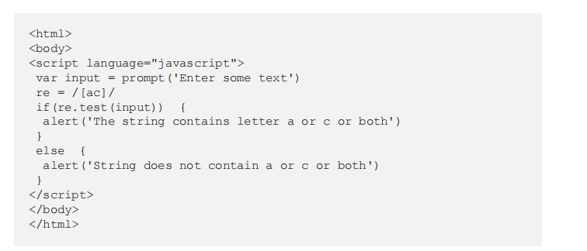
Sample program

Slide 16
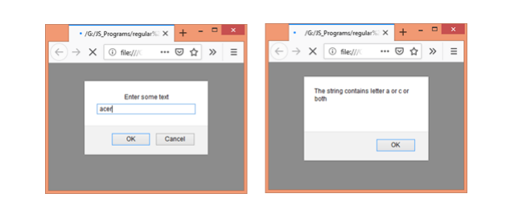
Sample program output

Slide 17
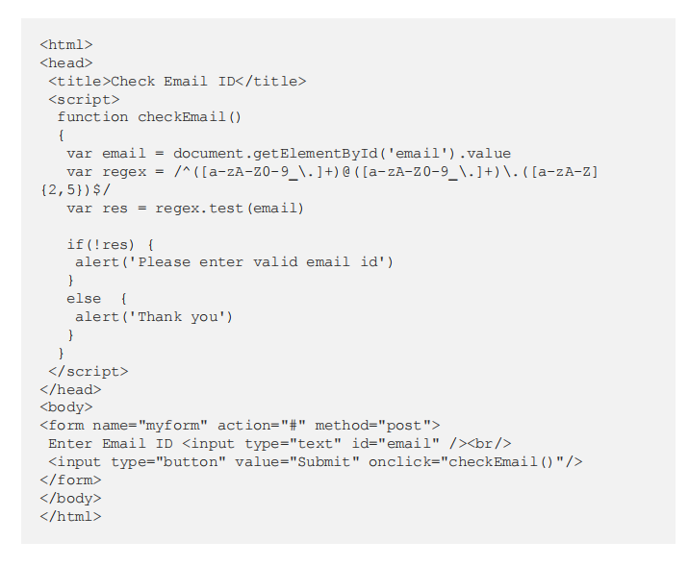
sample program

Slide 18
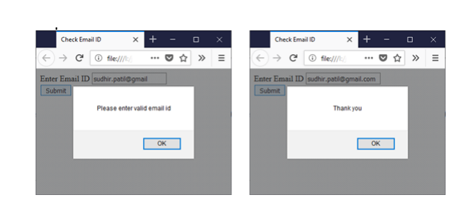
Sample program output

Slide 19
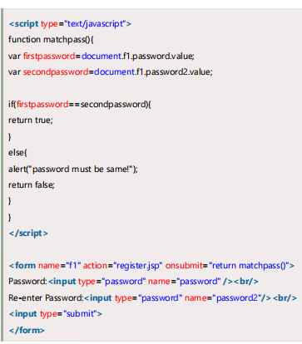
Sample program
JavaScript Retype Password Validation

Slide 20
Practical Exercises
Write a JavaScript program to check whether a string starts with 'Java' and false otherwise?
Write a JavaScript program to check whether a string "Script" presents at 5th (index 4) position in a given string, if "Script" presents in the string return the string without "Script" otherwise return the original one.
Write a JavaScript program to capitalize the first letter of each word of a given string. “the quick black fox “

Slide 21
Reading Resources/Materials
Links
Paul Deitel,
javaT point,
rahultamkhane.medium.com,
developer.mozilla.org

Slide 22
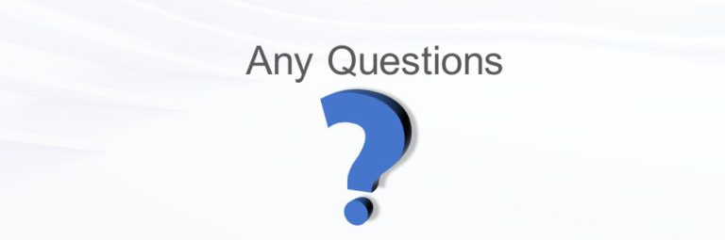
Thank You
For Your Attention!!

